Slide 1
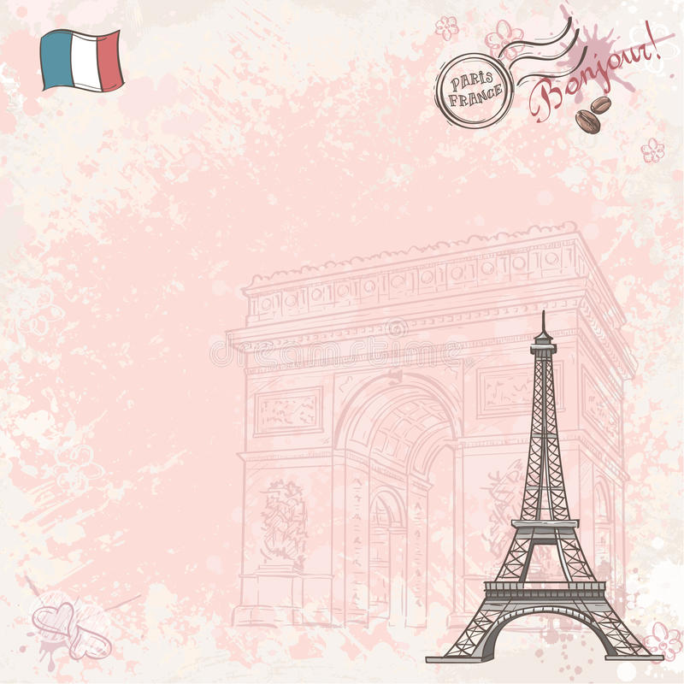

Paris

Slide 2
Introducing Paris
Paris, the capital of France, is a major European city and a global center for art, fashion, gastronomy and culture. It is also known as the City of Light (La Ville Lumière) or the City of Love and it was initially called Lutetia during Roman times. Paris is one
of the most popular cities in the world, gathering over 25 million tourists annually. However the most visited place isn’t the Eiffel Tower as some might think, but Disneyland, with over 13 million visitors annually.

Slide 3
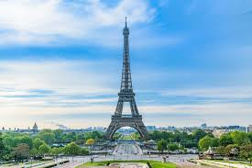
Eiffel Tower
In 1889 to celebrate the French Revolution's centennial year during the Exposition Universelle at the Champs de Mars. It is one of the modern wonders of the world .It has three floors. It is also a symbol of Paris . It is one of the world’s most admired architectural marvels which was mocked and insulted by many artists as it was built . French novelist Leon Bloy called it ‘this truly tragic streetlamp’. But now it is almost everyone’s favorite and one of the world’s most beautiful structure. Not only is it the most visited attraction in Paris, and indeed the icon of Paris. It’s also got a famous and interesting history!
The Eiffel Tower epitomises Paris’ reputation as the City of Light. Glowing every night above the city, there’s nothing else quite like it. Built in 1889, the wrought-iron lattice tower was originally criticized for its strange design, and considered impractical. Now, of course, it’s a French cultural icon!
This Paris monument held the title of ‘tallest man-made structure in the world’ for 41 years before it was trumped in 1930 by New York’s Chrysler Building.

Slide 4
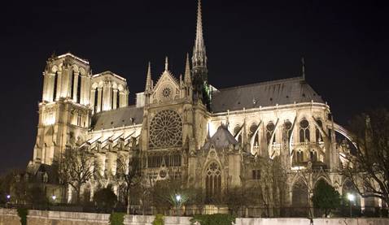
Notre Dame Cathedral
It is one of the example of gothic architecture. Notre Dame de Paris is perhaps France's most famous landmark: standing tall at the heart of the city for centuries, accepting the people's reverance one day, then facing their rejection on another. Its history was forever changed Monday when a massive fire broke out causing the medieval structure's spire to collapse. Devastatingly burnt in 2019, the Notre Dame remains one of the most famous and spectacular Paris landmarks! In fact, it’s fame has only grown as the whole world came together to mourn the loss.
A pioneer of the Gothic architectural style with flying buttresses, rib vaults and abundant sculpture, the building is a Gothic icon.

Slide 5
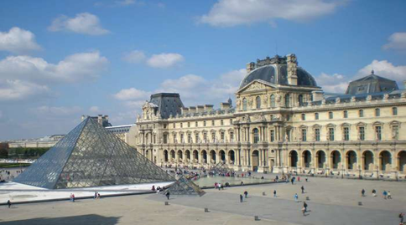
Louvre Museum
The Louvre is the world's largest museum and houses one of the most impressive art collections in history. The magnificent, baroque-style palace and museum — LeMusée du Louvre in French — sits along the banks of the Seine River in Paris. It is one of the city's biggest tourist attractions. The painting of Mona Lisa is also in this museum. The architect of this museum was I.M. Pei. He was famous for his idea of using geometrical shapes in the architecture. The Louvre is one of the most beautiful and impressive of French monuments! Originally a fortress built in the 14th century, it was used often as the Royal palaces of various French kings!
Walk where royalty has been, and marvel at the many historic artifacts and beautiful art pieces housed here. Even if you don’t go in, the iconic structure is so beautiful, it’s not to be missed!
One of Paris’ most photo-worthy sights is also right outside – the Louvre Pyramid! This glass and metal pyramid is almost as famous as its historical backdrop, in fact. One of the most famous buildings in Paris!

Slide 6
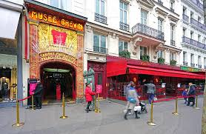
Grevin Museum
The Musée Grévin now contains some 450 characters arranged in scenes from the history of France and modern life, including a panorama of French history from Charlemagne to Napoleon III and bloody scenes of the French Revolution, with the original wax figures of the late 19th and early 20th centuries witnessing their technical evolution. By contrast, the more contemporaneous movie stars, athletes, and international figures such as Albert Einstein, Mahatma Gandhi, Shah Rukh Khan, Pablo Picasso, Michael Jackson, Josephine Baker and Pope John Paul II use the modern techniques of modeling. The tableau of Charlotte Corday murdering Jean-Paul Marat created in 1889 includes the actual knife and bathtub used.
New wax characters are regularly added to the Museum among more than 2000 made since it opened.
The statues of Ladybug and Cat Noir the heroes of the animated series Miraculous: Tales of Ladybug and Cat Noir are also present here.

Slide 7
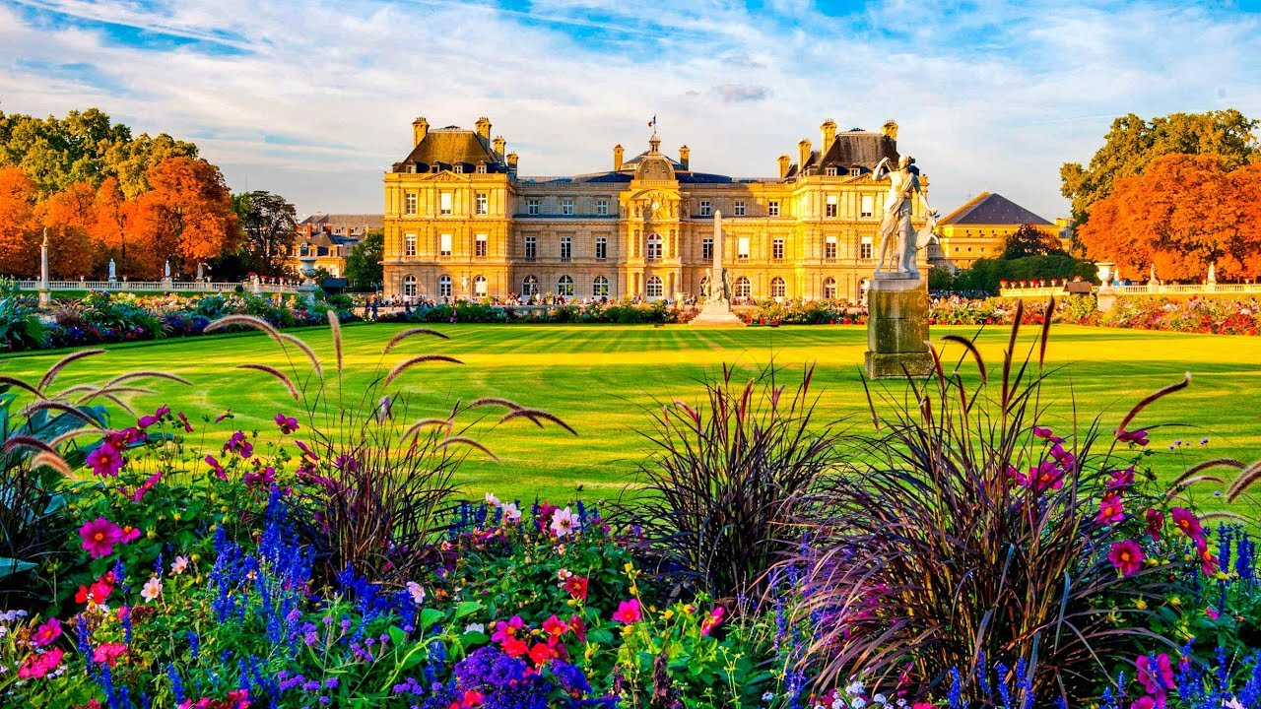
Luxembourg Garden
In 1611, Marie de' Medici, the widow of Henry IV and the regent for the King Louis XIII decided to build a palace in imitation of the Pitti Palace in her native Florence. She purchased the hotel du Luxembourg (today the Petit-Luxembourg palace) and began construction of the new palace. She commissioned Salomon de Brosse to build the palace and a fountain, which still exists. In 1612 she planted 2,000 elm trees, and directed a series of gardeners, most notably Tommaso Francini, to build a park in the style she had known as a child in Florence.Francini planned two terraces with balustrades and parterres laid out along the axis of the chateau, aligned around a circular basin. He also built the Medici Fountain to the east of the palace as a nympheum, an artificial grotto and fountain, without its present pond and statuary. The original garden was just eight hectares in size.
In 1630 she bought additional land and enlarged the garden to thirty hectares, and entrusted the work to Jacques Boyceau de la Barauderie, the indendant of the royal gardens of Tuileries and the early garden of Versailles. He was one of the early theorists of the new and more formal garden à la française, and he laid out a series of squares along an east–west alley closed at the east end by the Medici Fountain, and a rectangle of parterres with broderies of flowers and hedges in front of the palace. In the center he placed an octagonal basin with a fountain, with a perspective toward what is now the Paris observatory.

Slide 8
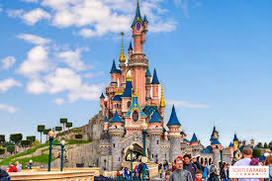
Disneyland
Disneyland Paris, formerly Euro Disney Resort, is an entertainment resort in Chessy, France, a new town located 32 km (20 mi) east of the centre of Paris. ... Disneyland Park is the original theme park of the complex, opening with the resort on 12 April 1992. Disneyland Paris, after all, is home to the stunning Sleeping Beauty Castle.

Slide 9
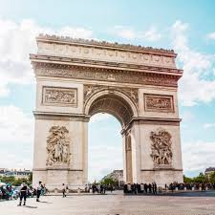
Arc De Triomphe
Arc de Triomphe, in full Arc de Triomphe de l’Étoile, massive triumphal arch in Paris, France, one of the world’s best-known commemorative monuments. The Arc de Triomphe is an iconic symbol of French national identity and took 30 years to build. The Tour de France bicycle race ends near it each year, and the annual military parade marking July 14—known both as French National Day and Bastille Day—begins its journey at the arch. Standing at the center of twelve radiating avenues, the ‘Triumphal Arch of the Star’, honors the heroes of the French Revolution and the Napoleonic Wars. One of Paris’ most famous monuments, the imposing structure is well worth a visit!
The names of French generals and victories cover the arch, inscribed on the inner and outer surfaces. Its iconography is triumphantly patriotic, and a fascinating thing to see. This makes it one of the most famous monuments of France!

Slide 10
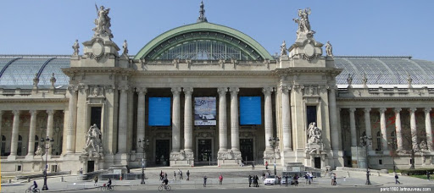
Grand Palais
The Grand Palais des Champs-Élysées, commonly known as the Grand Palaisis a large historic site, exhibition hall and museum complex located at the Champs-Élysées in the 8th arrondissement of Paris, France. Construction of the Grand Palais began in 1897 following the demolition of the Palais de l'Industrie (Palace of Industry) as part of the preparation works for the Universal Exposition of 1900, which also included the creation of the adjacent Petit Palais and Pont Alexandre III. It has been listed since 2000 as a monument historique by the French Ministry of Culture.
The structure was built in the style of Beaux-Arts architecture as taught by the École des Beaux-Arts of Paris. The building reflects the movement's taste for ornate decoration through its stone facades, the formality of its floor planning and the use of techniques that were innovative at the time, such as its glass vault, its structure made of iron and light steel framing, and its use of reinforced concrete.

Slide 11
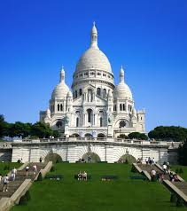
Sacré-Cœur
The Basilica of the Sacred Heart of Paris, commonly known as Sacré-Cœur Basilica and often simply Sacré-Cœur is a Roman Catholic church and minor basilica in Paris, France, dedicated to the Sacred Heart of Jesus. Sacré-Cœur Basilica is located at the summit of the butte Montmartre, the highest point in the city. It is a popular landmark, and the second-most visited monument in Paris. Sacré-Cœur Basilica has maintained a perpetual adoration of the Holy Eucharist since 1885.
The basilica was designed by Paul Abadie. Construction began in 1875 and was completed in 1914. The basilica was consecrated after the end of World War I in 1919.

Slide 12
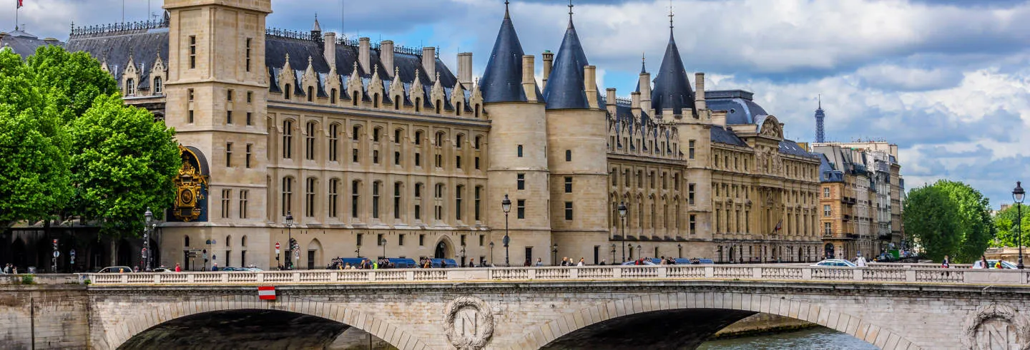
Conciergerie
The Conciergerie is a building in Paris, France, located on the west of the Île de la Cité, formerly a prison but presently used mostly for law courts. It was part of the former royal palace, the Palais de la Cité, which consisted of the Conciergerie, Palais de Justice and the Sainte-Chapelle. Hundreds of prisoners during the French Revolution were taken from the Conciergerie to be executed by guillotine at a number of locations around Paris.

Slide 13
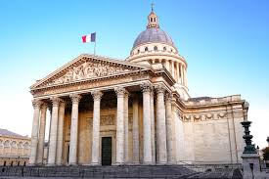
Panthéon
The Panthéon is a monument in the 5th arrondissement of Paris, France. It stands in the Latin Quarter, atop the Montagne Sainte-Geneviève, in the center of the Place du Panthéon, which was named after it. The edifice was built between 1758 and 1790, from designs by Jacques-Germain Soufflot, at the behest of King Louis XV of France; the king intended it as a church dedicated to Saint Genevieve, Paris' patron saint, whose relics were to be housed in the church. Neither Soufflot nor Louis XV lived to see the church completed.
By the time the construction was finished, the French Revolution had started, and the National Constituent Assembly voted in 1791 to transform the Church of Saint Genevieve into a mausoleum for the remains of distinguished French citizens, modelled on the Pantheon in Rome which had been used in this way since the 16th century.

Slide 14
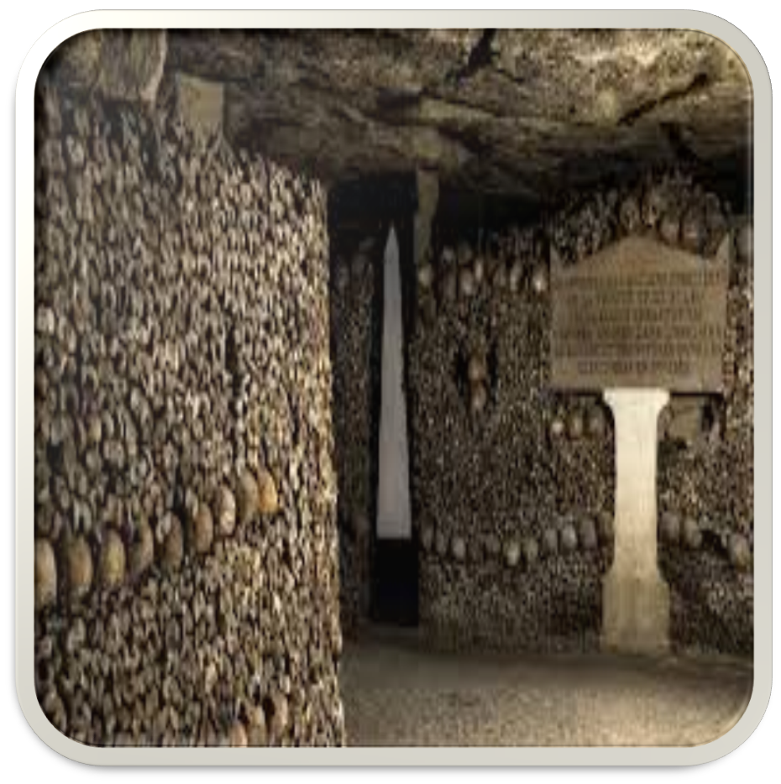
Catacombs
One of the darker monuments in Paris, the Catacombs are one of the most famous cemeteries in the world! With the remains of over 6 million people fit into a small part of Paris’ underground tunnels, it’s a daunting place.
The bodies are all there because of a health threat that arose from Paris’ cemeteries in the late 18th century. The practice of transferring these bodies, many of them ancient, continued well into the 19th century!
The site is so uncommon that it has made the darker side of Paris famous too!

Slide 15
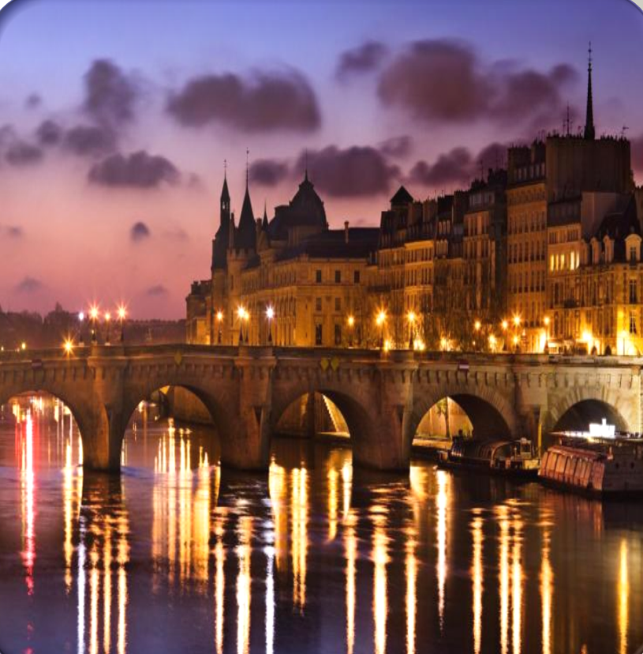
Seine River
One of the most famous landmarks in France, the Seine is also one of the world’s most famous rivers! Dividing the river into two neat halves, the river is important for so many reasons. While it is the loveliest way to see the Parisian landscape, cruising along on a boat tour, it has a rich history far beyond its beauty.
The Seine is the reason Paris exists today, supporting the city as a means of trade and commerce, as well as sustenance for millenia ! Today it is a UNESCO protected site, which allows it to remain in good condition.
Today the Seine is crossed by a total of 37 bridges in Paris! So while you’re in Paris you’re bound to see it, but be sure to spend some time strolling along and admiring the culturally significant river!

Slide 16
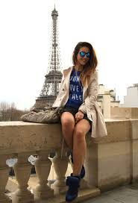
Fashion
Wondering what Paris is known for in the modern world? The great city is as famous these days for fashion as it is for anything else! Paris fashion week takes place in the city every year, where the world’s biggest celebrities and fashionistas come together to show off their style.
You’ll also enjoy the famous French fashion throughout the year. Parisians have such a unique sense of style and class!

Slide 17
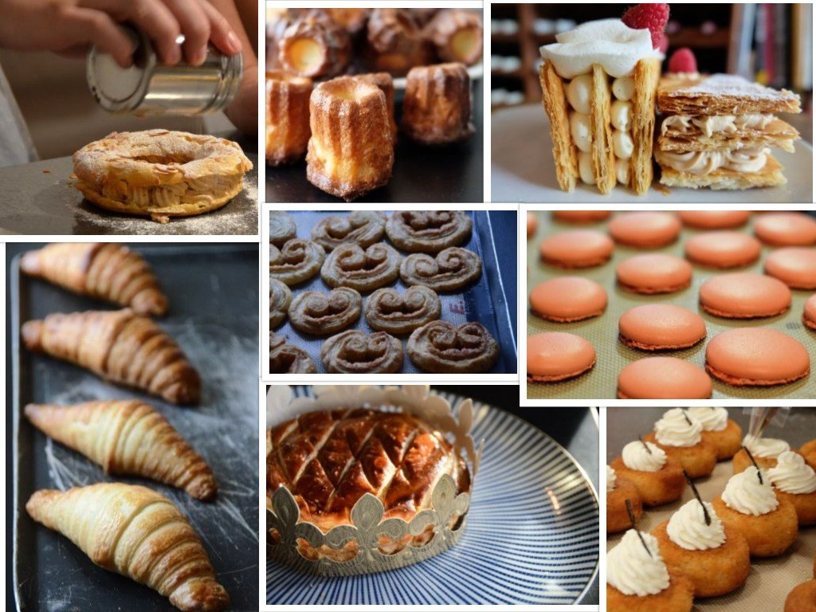
French Food
Paris is almost as famous for it’s fantastic and unique food as it is for its monuments! The most famous French food is, of course, baguettes and croissants. But there are far crazier food options in Paris.
Escargots, or ‘snails’, are one of the most famous Parisian dishes, and there’s an interesting variety of ways you can try them! Another amazing option is duck – Parisians are famous for the impressive dishes they make with duck, and their dedicated love for the meal!
If you’re a little daunted by the idea of eating snails or ducks, Paris and the greater France is also known for delicious, fluffy and sweet crepes.

Slide 18
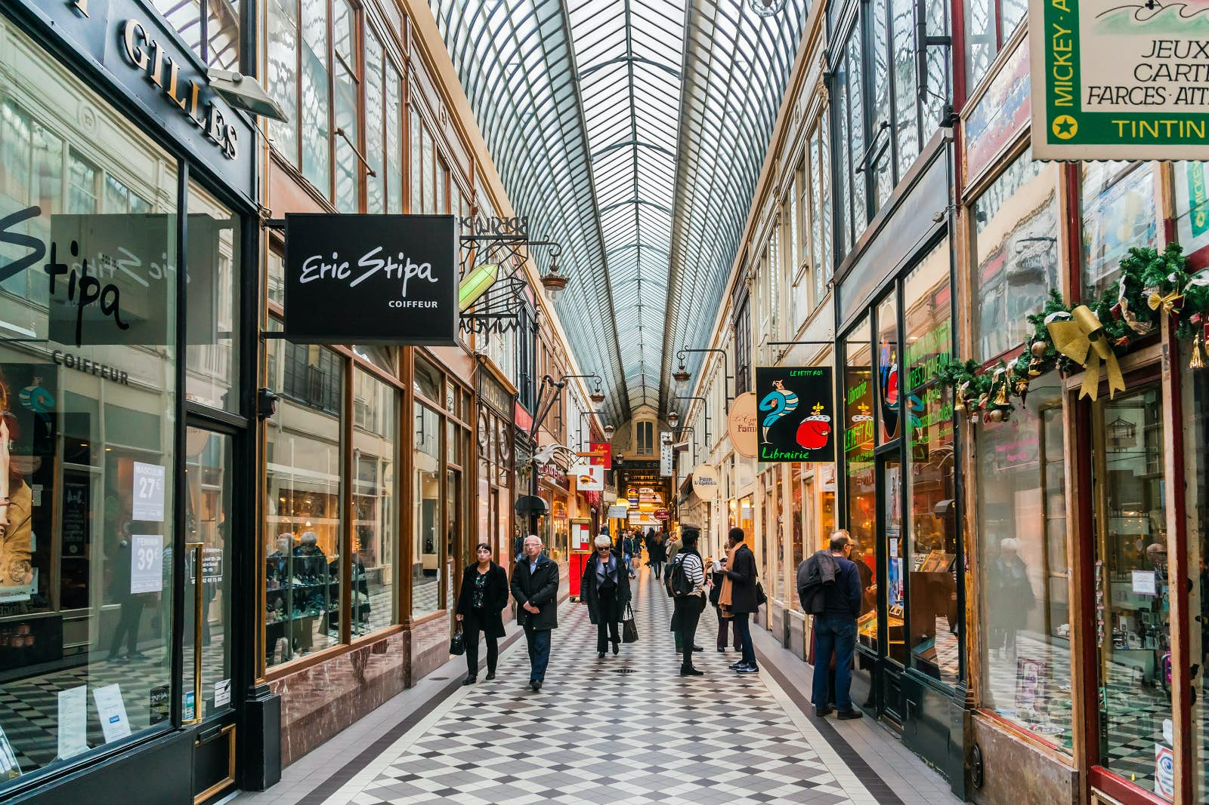
Shopping
Shopping in Paris feels like a whole different adventure. The luxurious department stores are so far set apart from anywhere else in the world, you simply have to see them! It’s the kind of place where window shopping might be better for most of us, but that shouldn’t stop you.
Possibly the most famous shopping center in Paris is the resplendent Galeries Lafayette! Massive and filled with gold gilding and glass, as well as some of the most high-end shopping in the world

Slide 19
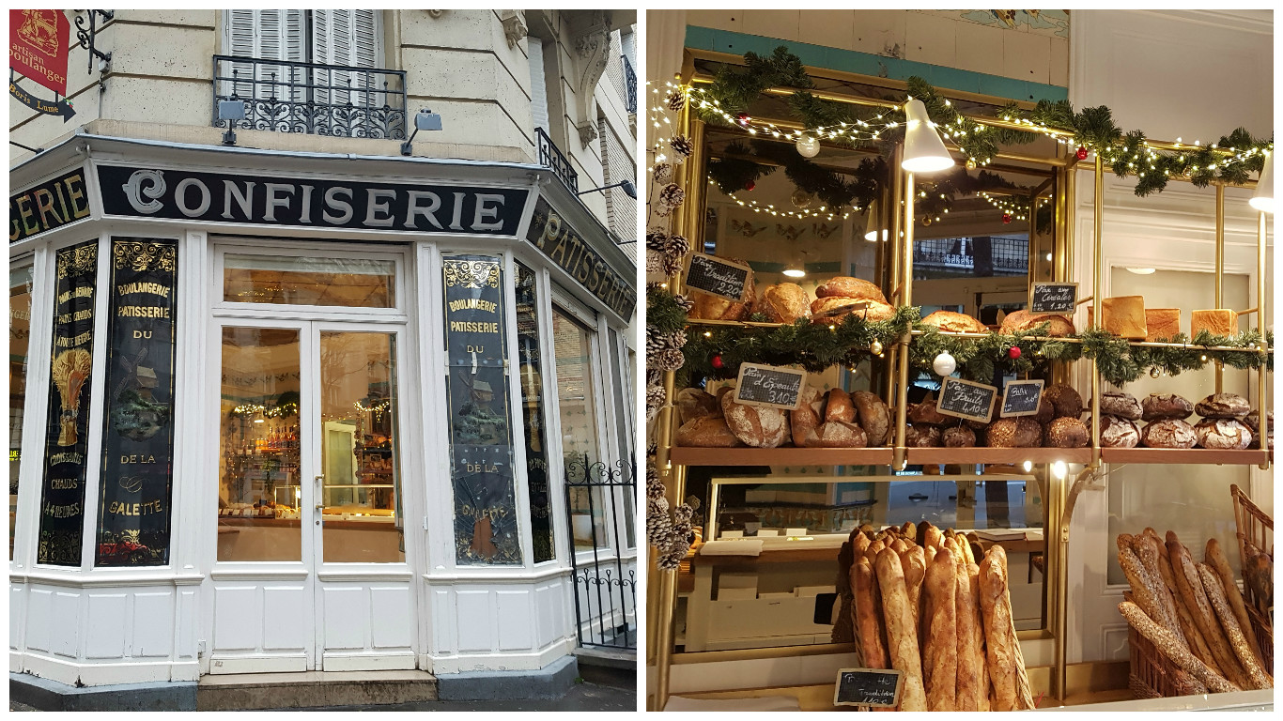
Cafes
When you think of Paris, do you imagine classy people in berets and light scarves sipping on something at a charming cafe? Because that’s what you’ll see in the city of lights!
Cafe life is an integral part of Parisian living. Whether working from a cafe, reading the newspaper with a coffee, or getting some pastries with friends, there are locals and tourists sitting at nearly every cafe, at every time of the day!
If you want to feel like a Parisian for the day, enjoy one of the more unique things to do in Paris! Dress up in your best, and head to a cafe to spend a languid hour or two enjoying pastries and confectionery!

Slide 20
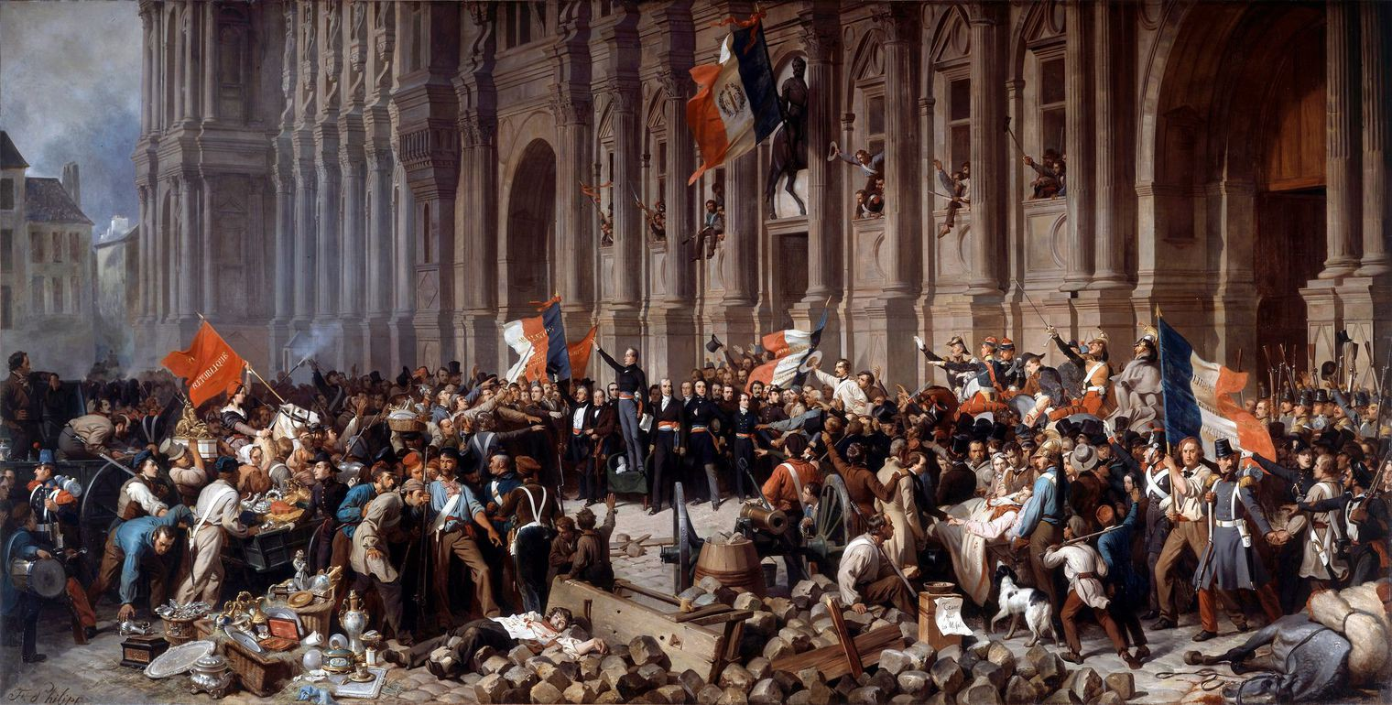
French Revolution
What is France known for? The French Revolution may be Paris and the greater France’s greatest fame! A social upheaval that set the stage for many other countries’ social and political changes, this revolution aimed to change the fabric of society.
During the revolution, the working class rose up to overthrow the gentry, who in their excesses were bleeding the poor dry. It was in this crazy time that Napoleon Bonapart took front stage!
You can learn some truly fascinating facts about Paris and the French Revolution at the Paris Carnavalet Museum.

Slide 21
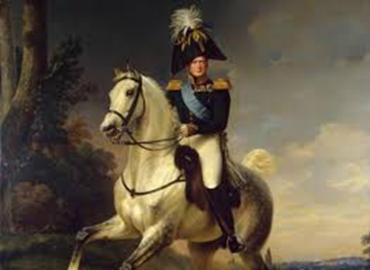
Napolean Bonaparte
Napoleon is one of the world’s most famous military figures! After rising quickly through the military ranks in Paris during the French Revolution, Napoleon seized political power and crowned himself Emperor!
With Napoleon in charge, France held control over most of Europe for over a decade. His changes, battles, and reforms have influenced the way the world works today, in a surprisingly far-reaching way!

Slide 22
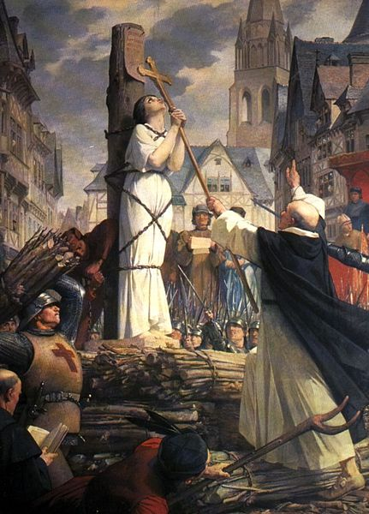
Joan of Arc
This Roman Catholic saint is France’s most famous and brilliant heroine! She played a large part in the Hundred Years War when she was just a girl, leading the French army to victory at the age of 18!
Joan was captured a year later and burnt at the stake as a heretic. She remains one of Paris’ most famous icons, hundreds of years later.
You can see a beautiful gold-gilded statue of Joan outside Place des Pyramides in Paris!

Slide 23
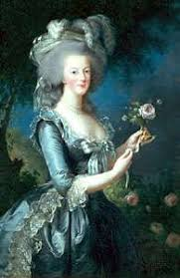
Marie Antoinette
‘Let them eat cake!’ This is the line that made Marie Antoinette infamous. While it sounds like a good idea to enjoy some pastry while you’re in Paris, it wasn’t such a popular sentiment at the time!
The famous queen didn’t necessarily ever say those words, but they cemented her in history just the same. She lived a decadent life in France, before being beheaded during the French Revolution. She’s a bit of a tragic figure, but represents France’s long time love for extravagance all the same!

Slide 24

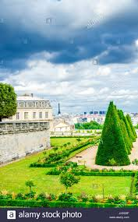
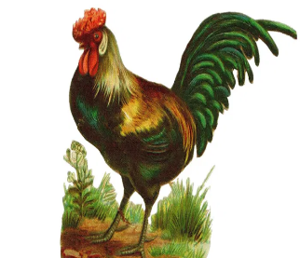
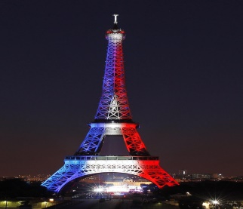
Capitals
The capital flower of France are Irises. The flower is very beautiful and is of purple color .
The capital tree of France are the Yews. They are cone shaped and also very adorable.
The capital animal/bird is Gallic Rooster . Very adorable and furious in looks.
The capital color of France is Blue and Red . The colors are of the nations Flag .

Slide 25
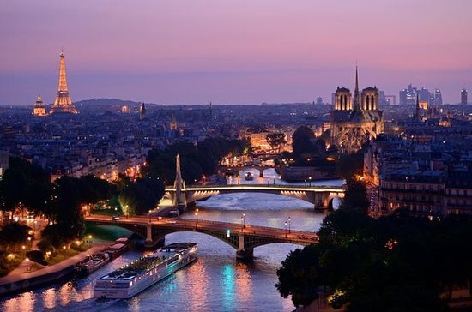
Paris is famous for such a fascinating variety of things! But when a city is more than 2000 years old, and has been for much of its existence a center of trade and class and also when it is the capital of France, it’s bound to have a very interesting past.

Slide 26
Created
by
Anushreya Satish

